Slide 1
Program Analysis for Quantitative Reachability Properties
Jiawen Liu
Advised by: Marco Gaboardi

Slide 2
Outline
Quantitative Reachability Properties
Adaptivity Analysis for Adaptive Data Analysis (In Improvement)
Query-While Language
Adaptivity Formalization
Program Analysis Algorithm
Path-sensitive Reachability-Bound Analysis (In Preparation)
Language Model
Reachability-Bound
Path-sensitive Reachability-Bound Analysis Algorithm
Status and Plan

Slide 3
Usefulness of Analyzing Program Properties
Improve Software Reliability :
Prove the execution correctness and control incorrect programs
Improve Program Scalability:
analysis of the resource cost and control resource usage
Protect Privacy of the Data through program:
analysis of the security property and prevent
Etc.
Controlling Certain Properties can better help improve program design than others.

Slide 4
Quantitative Reachability Properties
Safety:
whether secret is leaked? how much secret is leaked?
Data Dependency:
whether some data re used? how many times certain data is used?
Resource Usage, etc.
Reachable + Quantitative Aspects,
Two aspects better help improve program design.

Slide 5
Challenges : Technique Limitations
Control-flow, Data-flow or Liveness Analysis:
only whether certain code piece is executed or not → reachability
only whether some data is used → reachability
Dependency analysis techniques
only whether code piece execution / data depend on others → reachability
Cost Analysis:
only worst-case overall resource cost. → quantity

Slide 6
Proposed the Methodology: Combination Analysis
Reachability Analysis Techniques including,
Control-flow, Data-flow and Liveness Analysis
Dependency Analysis
Quantitative Analysis Techniques including,
Resource Cost Analysis
Program Complexity Analysis
Worst-Case Execution Time Analysis
Loop Bound Analysis

Slide 7
Two Interested Quantitative Reachability Properties
Adaptivity in An Adaptive Data Analysis
Help to improve the “accuracy” of the results in data analysis programs.
Reachability-Bound
Help to improve the analysis result on other program features such as:
computing tight bound on program resource cost, execution time, etc.
estimating the program’s information leakage, uncertainty propagation, etc. accurately.
analyzing “adaptivity” above precisely.
Help to improve program performance based on the improved analysis results.

Slide 8
PART I : Program Analysis for Adaptive Data Analysis (In Improvement)

Slide 9
Adaptive Data Analysis
discover / predicate
unknown population
data set
X
Combination of multiple queries over X
analysis result
sample
request query on X
Data Analysis

Slide 10


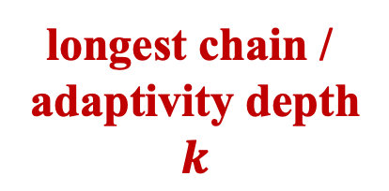


Adaptive Data Analysis – Simple Example
input
X
$${query}_{1} (X)$$
some queries rely on the results of other queries
longest chain /
adaptivity depth
$$k$$
$${query}_{2}( ,X)$$
$${query}_{3}( ,X)$$
…
output
analysis
results
$${query}_{k}( ,X)$$

Slide 11
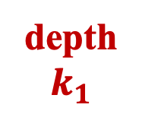





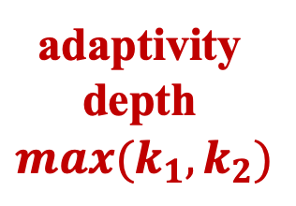

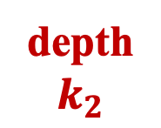
Adaptive Data Analysis – non-Trivial Example
input
X
$${query}_{1}(X)$$
$${query}_{2}(X)$$
$${query}_{3}(X)$$
$${query}_{4}( ,X)$$
$${query}_{5}( ,X)$$
adaptivity depth
$$max(k_{1}, k_{2})$$
depth
$$k_{1}$$
depth
$$k_{2}$$
…
…
…
$${query}_{n}( ,X)$$
analysis
results
output

Slide 12
Generalization Error / Overfitting
fits bad
genl. error
fits well
unknown population
data set
X
Combination of multiple queries over X
analysis result
sample
Data Analysis
Adaptivity in analysis will propagate the overfitting

Slide 13
Mechanisms for Reducing Generalization Error
Gaussian Mechanism
Laplace Mechanism
Threshold out
…
Guarantee generalization error
fits well
unknown population
data set
X
Mechanisms
analysis result
Combination of multiple queries over X
sample
Data Analysis
Guarantee will lose in multiple adaptive queries

Slide 14





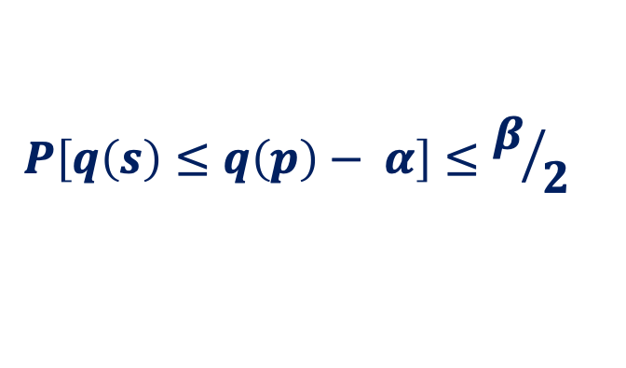
Theoretical Guarantee on Generalization Errors
Sample
Distribution
$$S$$
$$P$$
$$q(S)$$
$$\sim$$
$$q(P)$$
$$P\left[q\left(s\right)≤q\left(p\right)− α\right]≤β/2$$

Slide 15
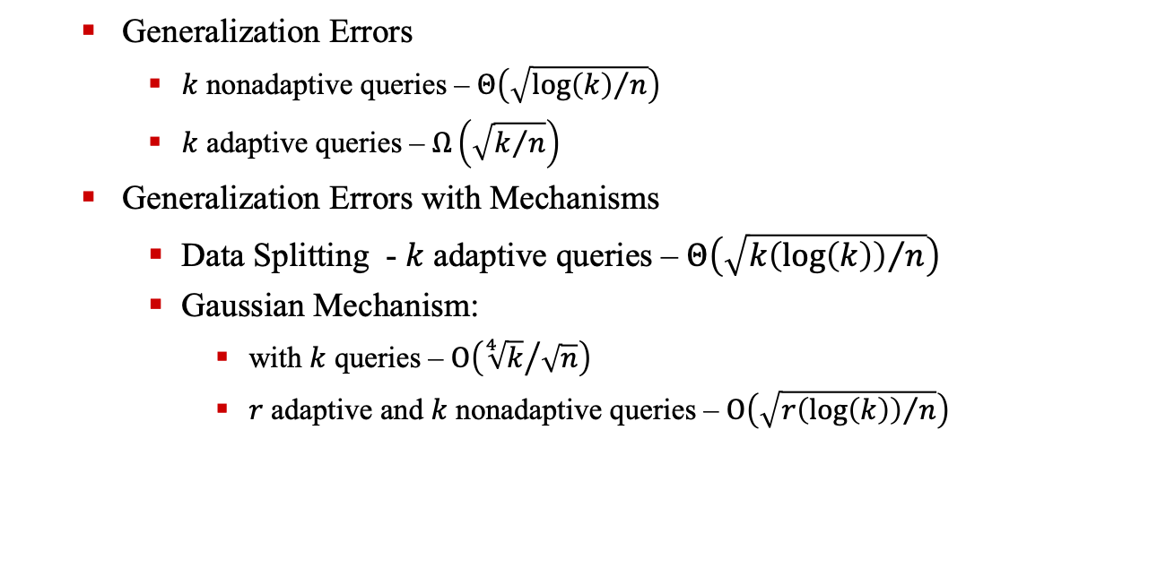
Theoretical Guarantee on Generalization Errors in Adaptive Data Analysis
Generalization Errors
$k$ nonadaptive queries – $Θ\left(\sqrt{{\log\left(k\right)}/n}\right)$
$k$ adaptive queries – $Ω\left(\sqrt{k/n}\right)$
Generalization Errors with Mechanisms
Data Splitting - $k$ adaptive queries – $Θ\left(\sqrt{{k\left(\log\left(k\right)\right)}/n}\right)$
Gaussian Mechanism:
with $k$ queries – $Ο\left({\sqrt[4]{k}}/{\sqrt{n}}\right)$
$r$ adaptive and $k$ nonadaptive queries – $Ο\left(\sqrt{{r\left(\log\left(k\right)\right)}/n}\right)$

Slide 16
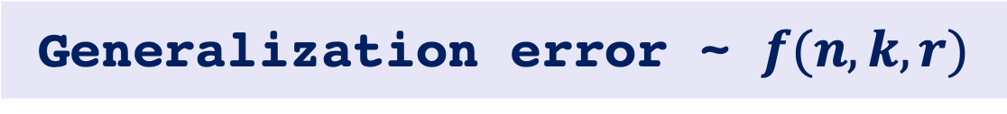
Motivation for Analyzing the Adaptive Data Analysis Program
Generalization error ~ $f(n, k, r)$
?
Formal Verification
or Analysis
Theory proofs
Algorithm
implementation
program

Slide 17
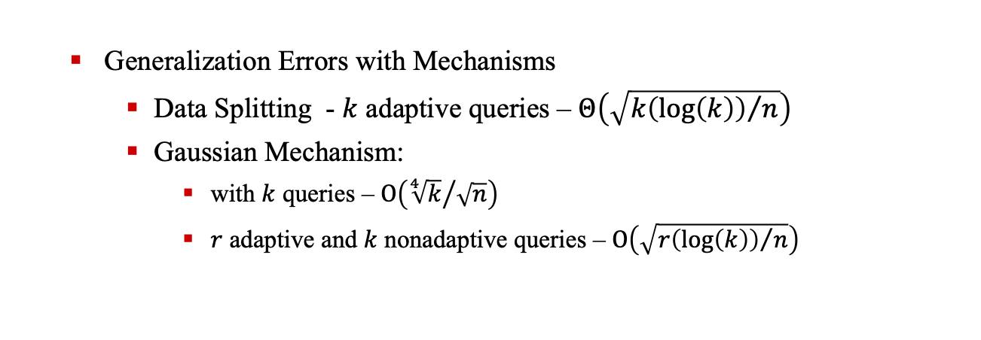

Motivation For Analysis Program’s Adaptivity Rounds
Generalization error: $f( n, k, r )$
Generalization Errors with Mechanisms
Data Splitting - $k$ adaptive queries – $Θ\left(\sqrt{{k\left(\log\left(k\right)\right)}/n}\right)$
Gaussian Mechanism:
with $k$ queries – $Ο\left({\sqrt[4]{k}}/{\sqrt{n}}\right)$
$r$ adaptive and $k$ nonadaptive queries – $Ο\left(\sqrt{{r\left(\log\left(k\right)\right)}/n}\right)$

Slide 18
Motivation For Analysis Program’s Adaptivity Rounds
Adaptivity
Where to apply mechanisms
How many mechanisms needed
Light or intense mechanism
…
Guarantee Generalization Error

Slide 19
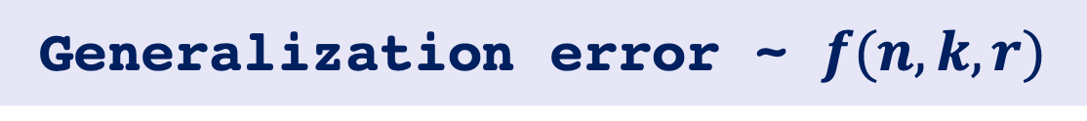
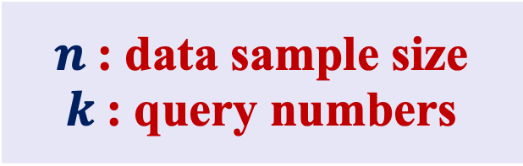
Motivation For Analysis Adaptivity Quantity
Generalization error ~ $f(n, k, r)$
Easily Track
Challenge
$n$: data sample size
$k$: query numbers
Adaptive query numbers

Slide 20
Research Challenges &. Goals
input
X
$${query}_{1}(X)$$
$${query}_{2}(X)$$
$${query}_{3}(X)$$
$${query}_{4}( ,X)$$
$${query}_{5}( ,X)$$
adaptivity depth
$$max(k_{1}, k_{2})$$
depth
$$k_{1}$$
depth
$$k_{2}$$
…
…
…
$${query}_{n}( ,X)$$
analysis
results
output

Slide 21
Research Challenges &. Goals
Challenge – I : Adaptive Data Analysis Formalization
Query-While Language Design
Challenge – II : Adaptivity Formalization
Execution-Based Adaptivity Analysis
Challenge – III : Adaptivity Estimation
Static Program Adaptivity Analysis

Slide 22
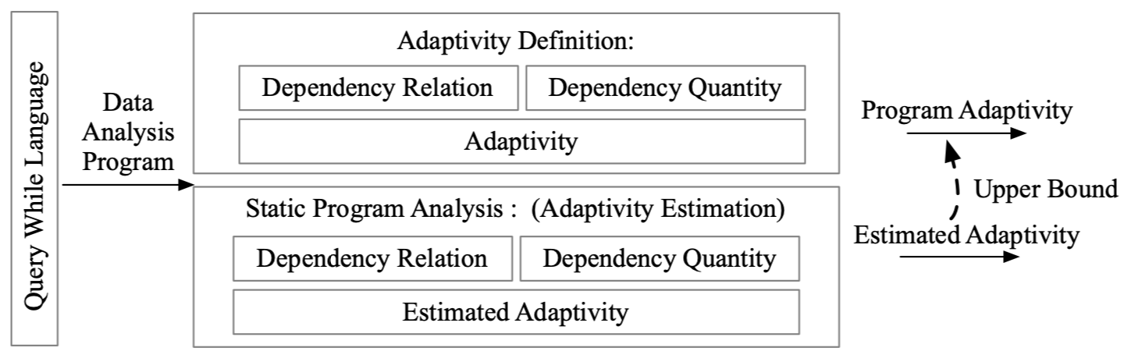
Adaptivity Analysis Framework

Slide 23
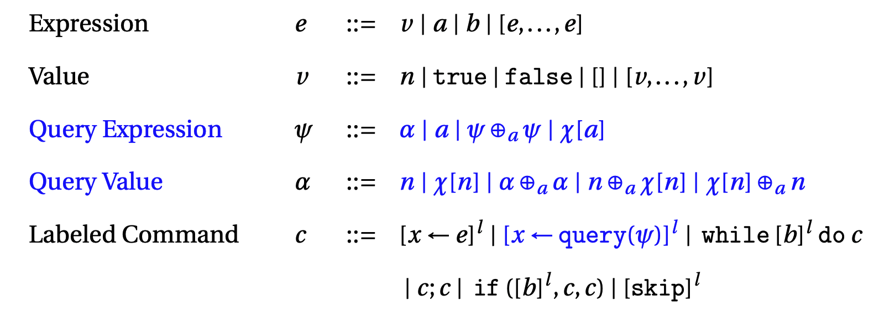
Query-While Language Design

Slide 24
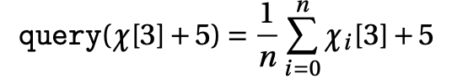
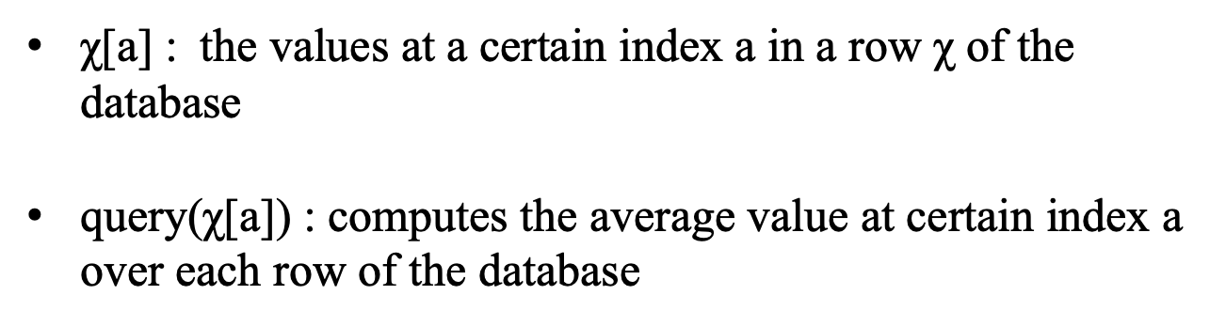
Query-While Language Design – Query Expression
χ[a] : the values at a certain index a in a row χ of the database
query(χ[a]) : computes the average value at certain index a over each row of the database

Slide 25
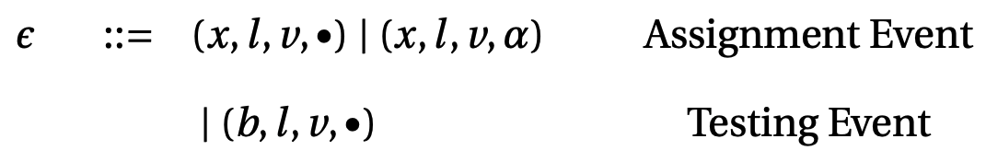

Query-While Language Design – Trace-based Semantics
Event
Trace

Slide 26
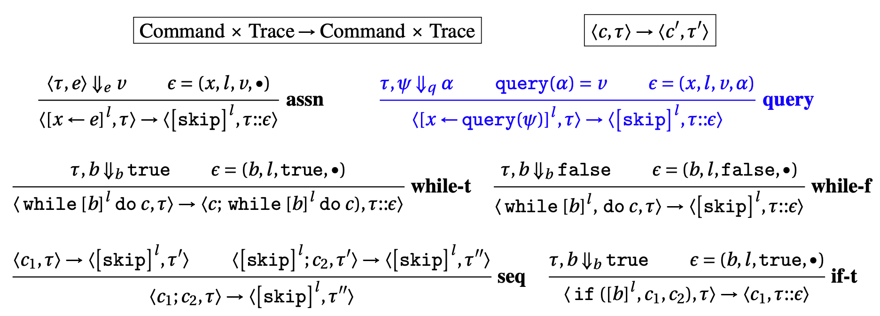
Query-While Language Design – Trace-based Semantics
Operational Semantics Rules

Slide 27
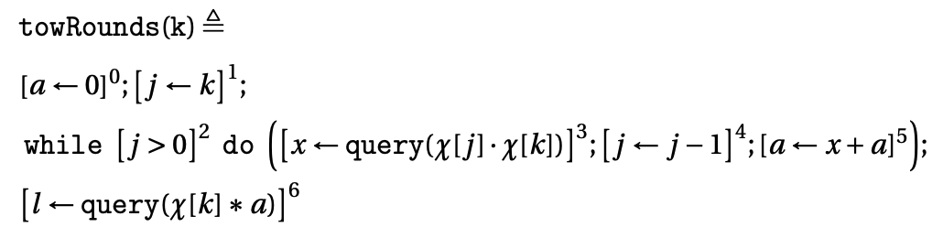
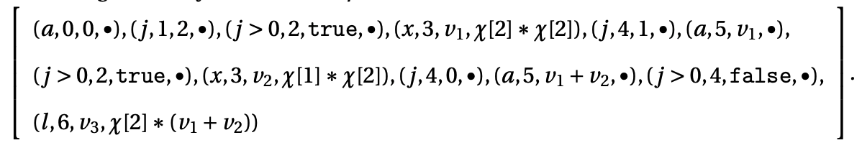
Example - Evaluation Trace
Evaluation Trace: (initial trace: $(k, in, 2, •)$)

Slide 28
Adaptivity Formalization
Data Dependency Relation
Data Dependency Quantity
Adaptivity Definition

Slide 29
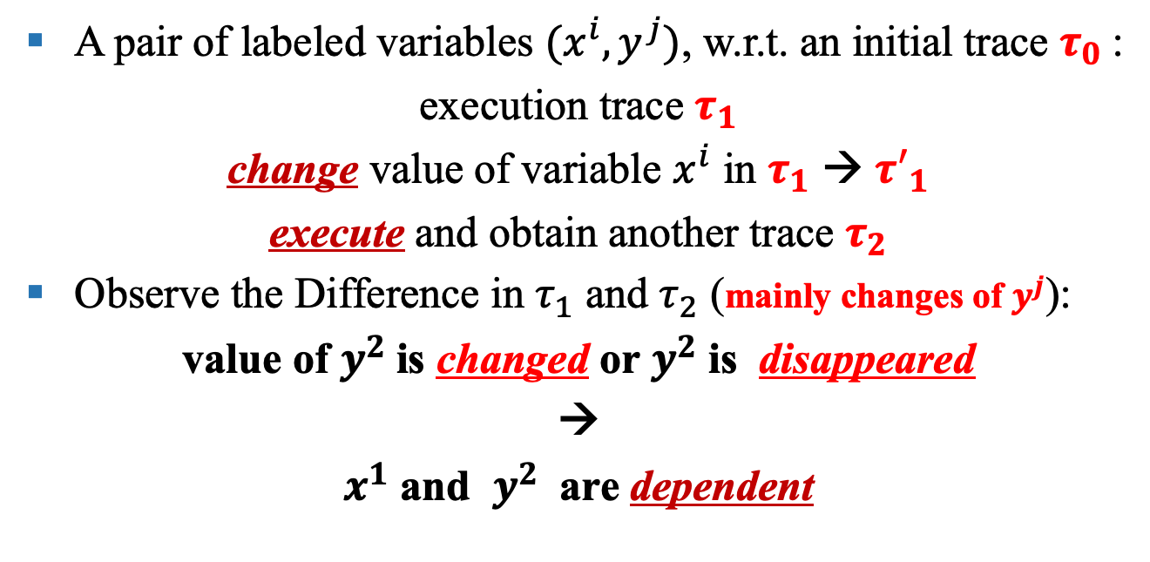
Data Dependency Relation Analysis
A pair of labeled variables ${(x}^{i}, y^{j})$, w.r.t. an initial trace $τ_{0}$:
execution trace $τ_{1}$
change value of variable $x^{i}$ in $τ_{1}$ → ${τ′}_{1}$
execute and obtain another trace $τ_{2}$
Observe the Difference in $τ_{1}$ and $τ_{2}$ (mainly changes of $y^{j}$):
value of $y^{2}$is changed or $y^{2}$ is disappeared
→
$x^{1}$ and $y^{2}$ are dependent

Slide 30
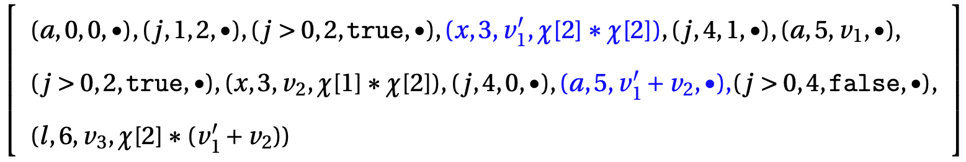
Example - Dependency Relation
Dependency relation for $x^{3}$ and $a^{5}$

Slide 31

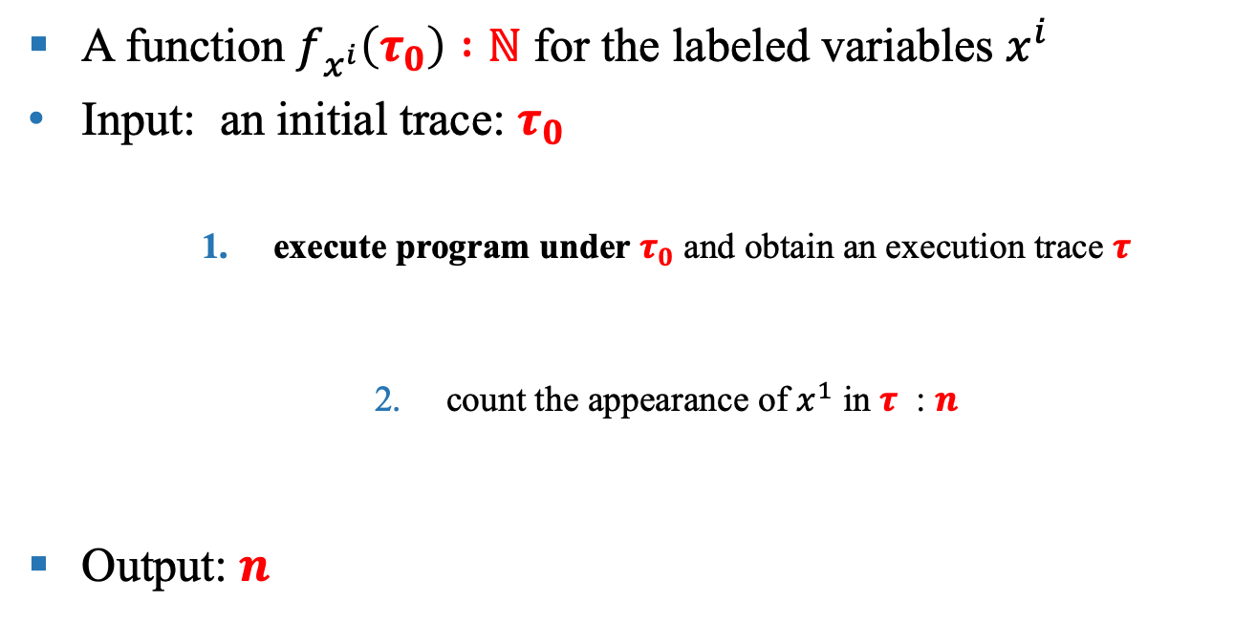


Dependency Quantity
A function $f_{x^{i}}\left(τ_{0}\right) :ℕ$ for the labeled variables $x^{i}$
Input: an initial trace: $τ_{0}$
execute program under $τ_{0}$ and obtain an execution trace $τ$
count the appearance of $x^{1}$ in $τ$ : $n$
Output: $n$
$τ_{0}$
$τ$
$n$

Slide 32
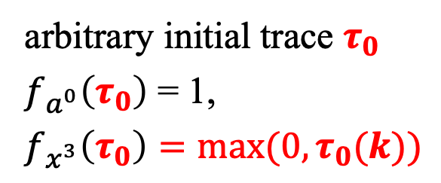
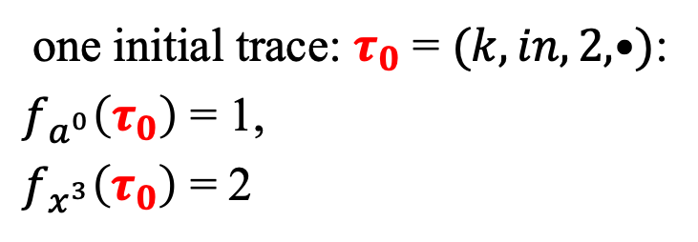
Example - Dependency Quantity ($a^{0}$ and $x^{3}$ for example)
one initial trace: $τ_{0}$ = $(k, in, 2, •)$:
$f_{a^{0}}\left(τ_{0}\right)$ = 1,
$f_{x^{3}}\left(τ_{0}\right)$ = 2
arbitrary initial trace $τ_{0}$
$f_{a^{0}}\left(τ_{0}\right)$ = 1,
$f_{x^{3}}\left(τ_{0}\right)=max(0,τ_{0}(k))$

Slide 33
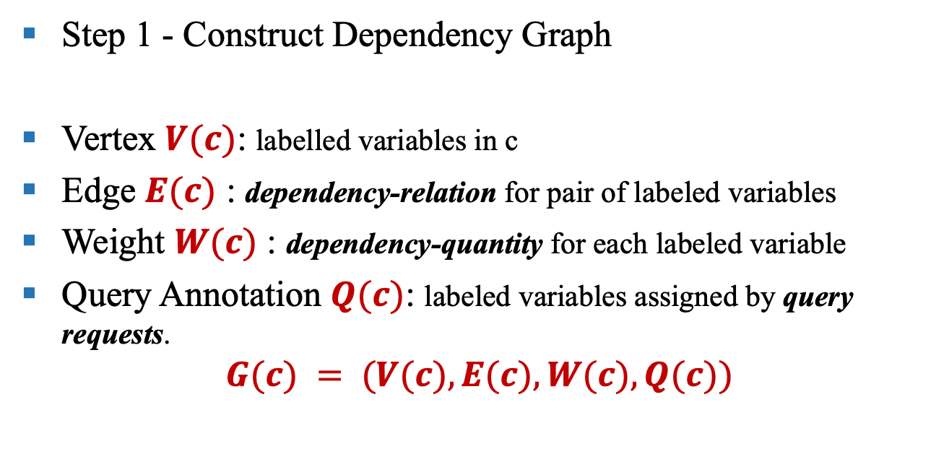
Adaptivity Formalization
Step 1 - Construct Dependency Graph
Vertex $V(c)$: labelled variables in c
Edge $E(c)$ : dependency-relation for pair of labeled variables
Weight $W(c)$ : dependency-quantity for each labeled variable
Query Annotation $Q(c)$: labeled variables assigned by query requests.
$$G(c) = (V(c), E(c), W(c), Q(c))$$

Slide 34
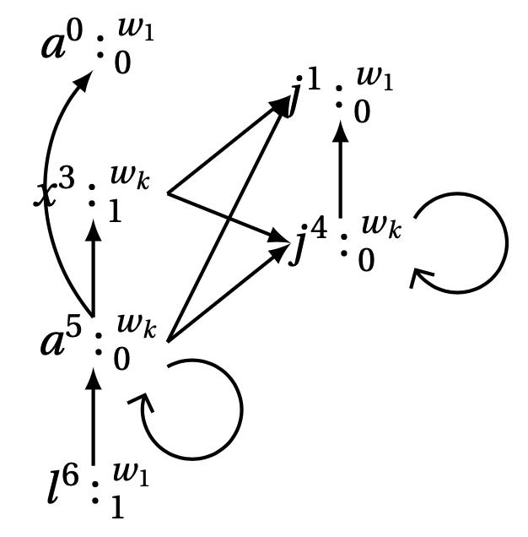
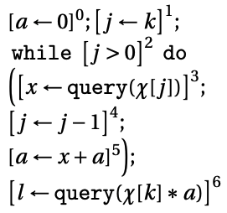
Example – Dependency Graph

Slide 35
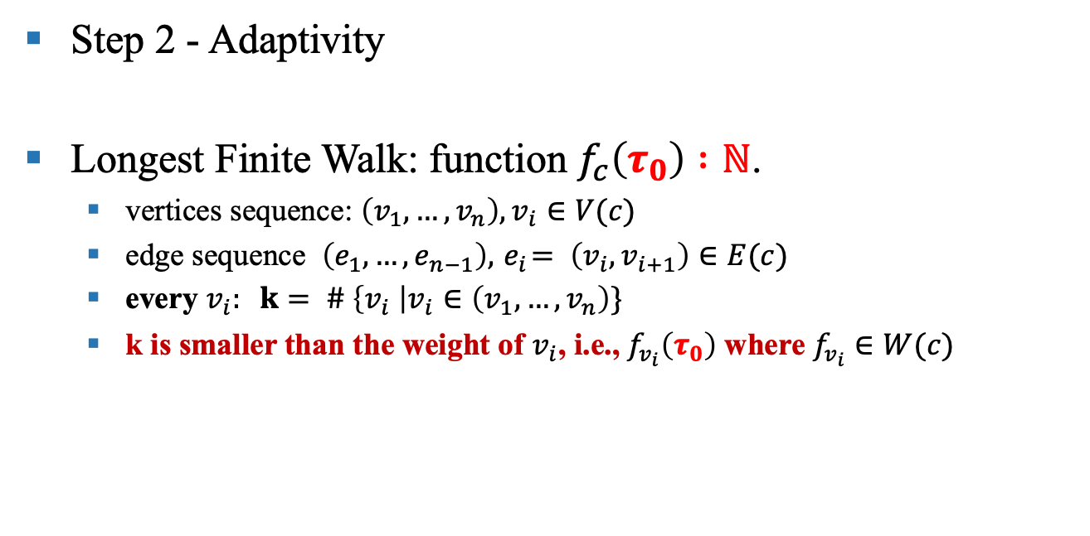
Adaptivity Formalization
Step 2 - Adaptivity
Longest Finite Walk: function $f_{c}\left(τ_{0}\right) :ℕ$.
vertices sequence: $\left(v_{1}, …,v_{n}\right),v_{i}∈V(c)$
edge sequence $\left(e_{1}, …,e_{n−1}\right),{ e}_{i}= \left(v_{i},v_{i+1}\right)∈E(c)$
every $v_{i}: k= \# \left\{v_{i} \right|v_{i}∈\left(v_{1}, …,v_{n}\right)\}$
k is smaller than the weight of $v_{i}$, i.e., $f_{v_{i}}\left(τ_{0}\right)$ where $f_{v_{i}}∈W(c)$

Slide 36
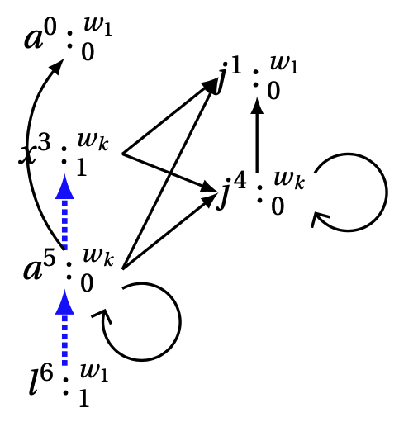
Adaptivity Formalization – Longest Finite Walk

Slide 37
Static Program Adaptivity Analysis
Data Dependency Relation Estimation
Data Dependency Quantity Estimation
Adaptivity Estimation
Control Flow and Program Abstract Based Static Analysis

Slide 38
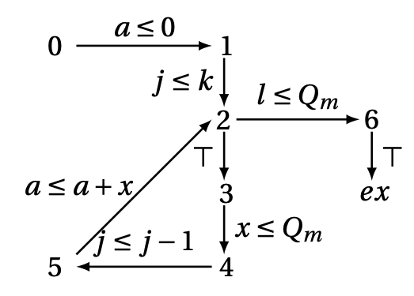
Base Step
Example - Abstract Control Flow Graph

Slide 39
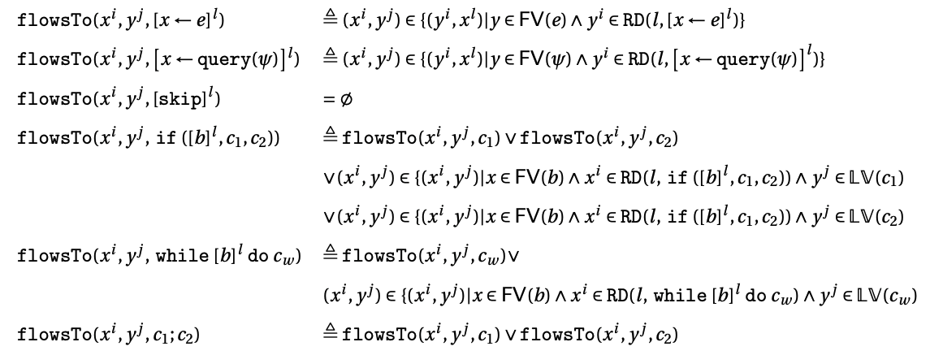
Data Dependency Relation Estimation
Standard Reaching Definition Algorithm

Slide 40
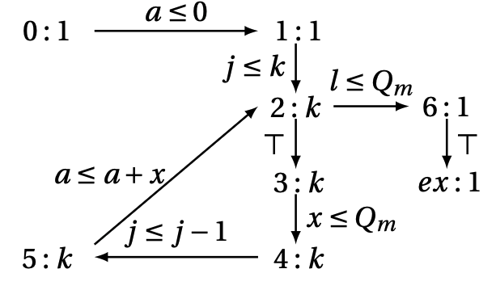
Dependency Quantity Estimation
Reachability Bound Analysis

Slide 41
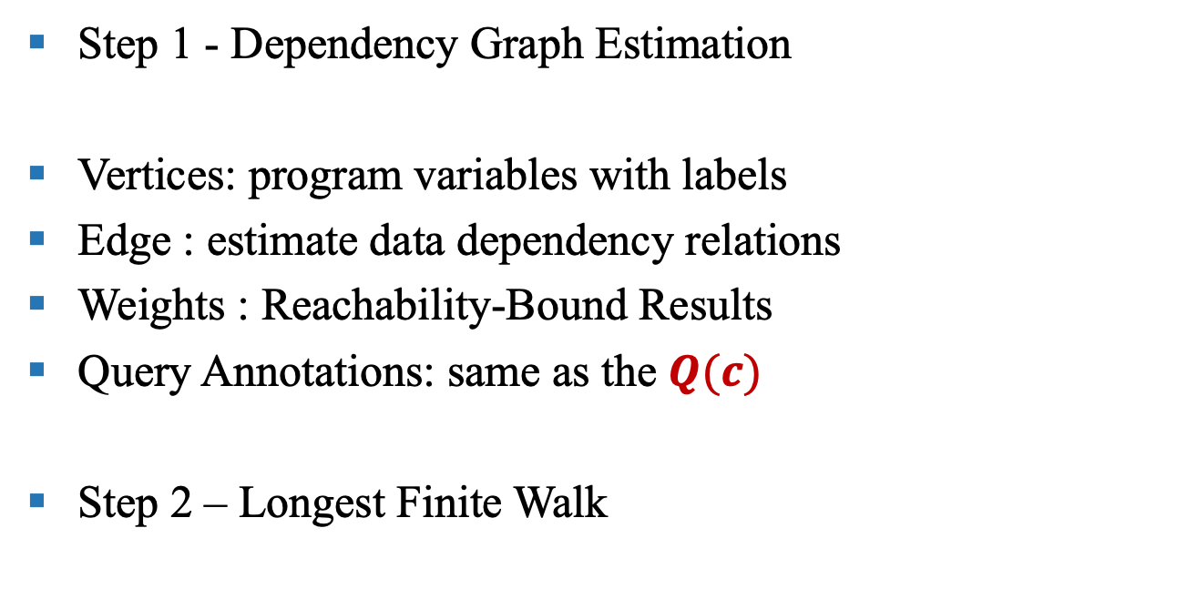
Adaptivity Estimation
Step 1 - Dependency Graph Estimation
Vertices: program variables with labels
Edge : estimate data dependency relations
Weights : Reachability-Bound Results
Query Annotations: same as the $Q(c)$
Step 2 – Longest Finite Walk

Slide 42
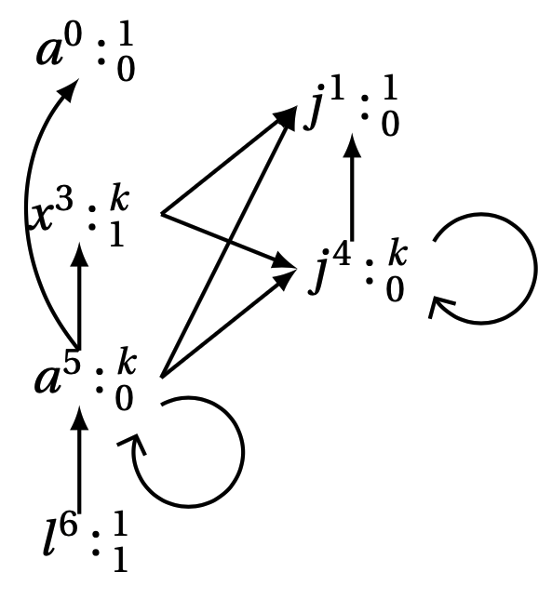
Example –Dependency Graph Estimation

Slide 43
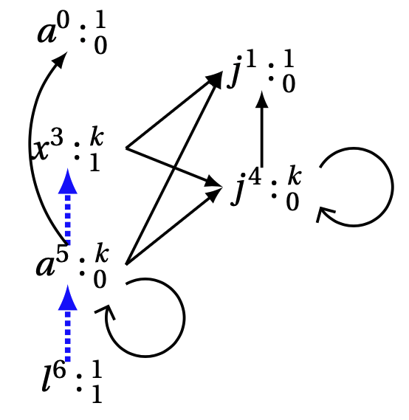
Adaptivity Estimation – Longest Finite Walk Estimation

Slide 44
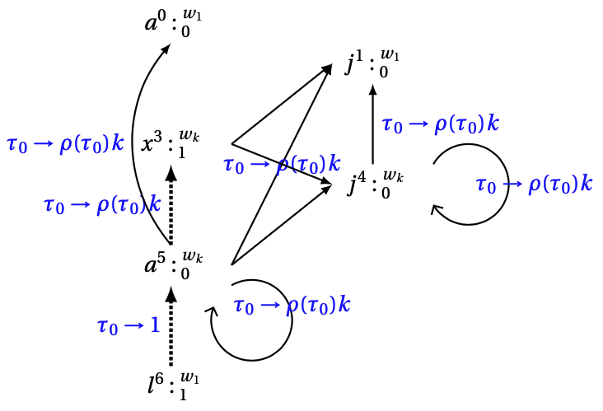
Improvement on Adaptivity Definition
Add weight on every transition path:

Slide 45
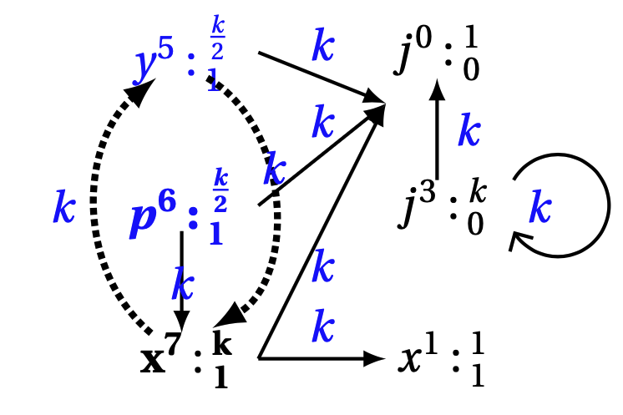
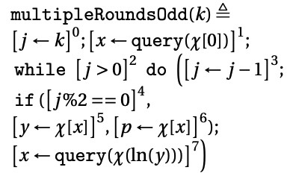
Improvement in Static Analysis
Path Sensitive Reachability Bound Analysis

Slide 46
Path-Sensitive Reachability-Bound Analysis (In Preparation)

Slide 47
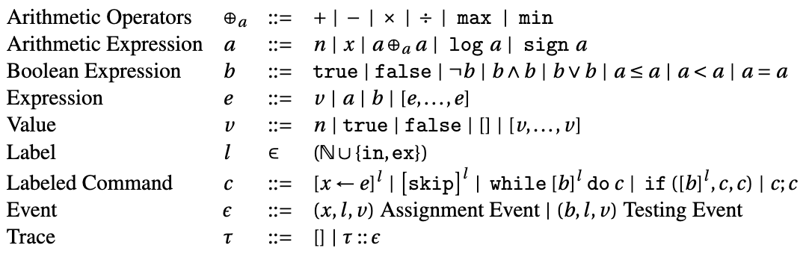
Language Model

Slide 48
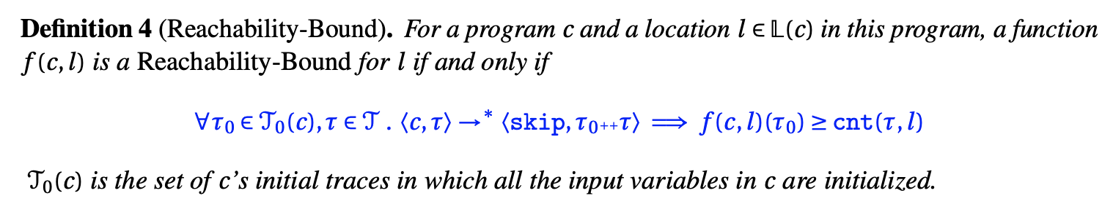
Reachability-Bound

Slide 49
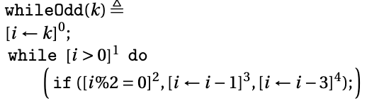
Analysis Algorithm Illustration through An Example
Generate An Abstract Control Flow Graph
Refine the Program
Compute the Bound locally for transitions
Compute the Bound globally for transitions
Compute the Reachability-Bound for each control location

Slide 50
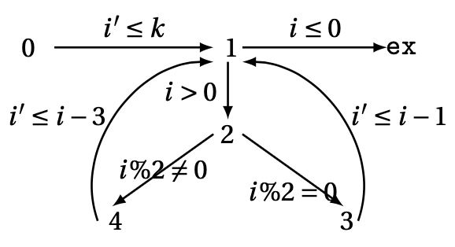
The Abstract Control Flow Graph for whileOdd

Slide 51
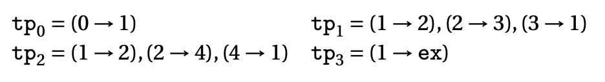
Refined Program
The Transition Paths
The Refined Program

Slide 52
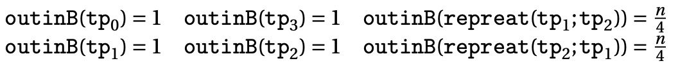
The Local Bounds for Transition Paths

Slide 53
The Global Bounds for Transition Paths

Slide 54
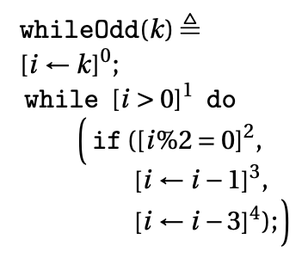
The Reachability-Bound for Each Control Location

Slide 55
Static Analysis Extension and Improvement
Path Sensitive Reachability Bound Analysis

Slide 56
Status and Plan
Status:
Part I implemented and submitted a conference paper.
Plan:
November 05, 2022: Submit the paper Path Sensitive Reachability Bound Analysis to PLDI 2023.
• February 4, 2023: Finish the thesis and submit to GRS office, to be approved by the Associate Dean. Submit the Intent to Graduate form.
• April 4, 2023: Final Oral Exam.

